Slide 1

ACE Primary Results Presentation
European Association for the Study of Diabetes
Lisbon, 13th September 2017
ISRCTN number: 91899513
ClinicalTrials.gov number: NCT00829660

Slide 2
Study Rationale, Design and Conduct

Slide 3
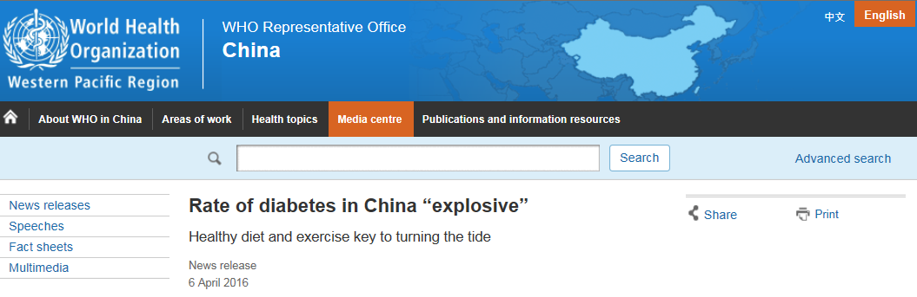
The Diabetes Burden
9.7% of all adults in China – about 110 million people currently live with diabetes¹
Without urgent action to reduce lifestyle risk factors like unhealthy diet and lack of physical activity, that number is expected to increase to 150 million with diabetes by 2040 with major health, social and economic consequences
Even more startling is the fact that almost half of all adults in China – close to 500 million people – have prediabetes²
Yang WY et al. N Engl J Med. 2010;362:1090-1101.
Xu Y et al. JAMA 2013;310:948-959

Slide 4
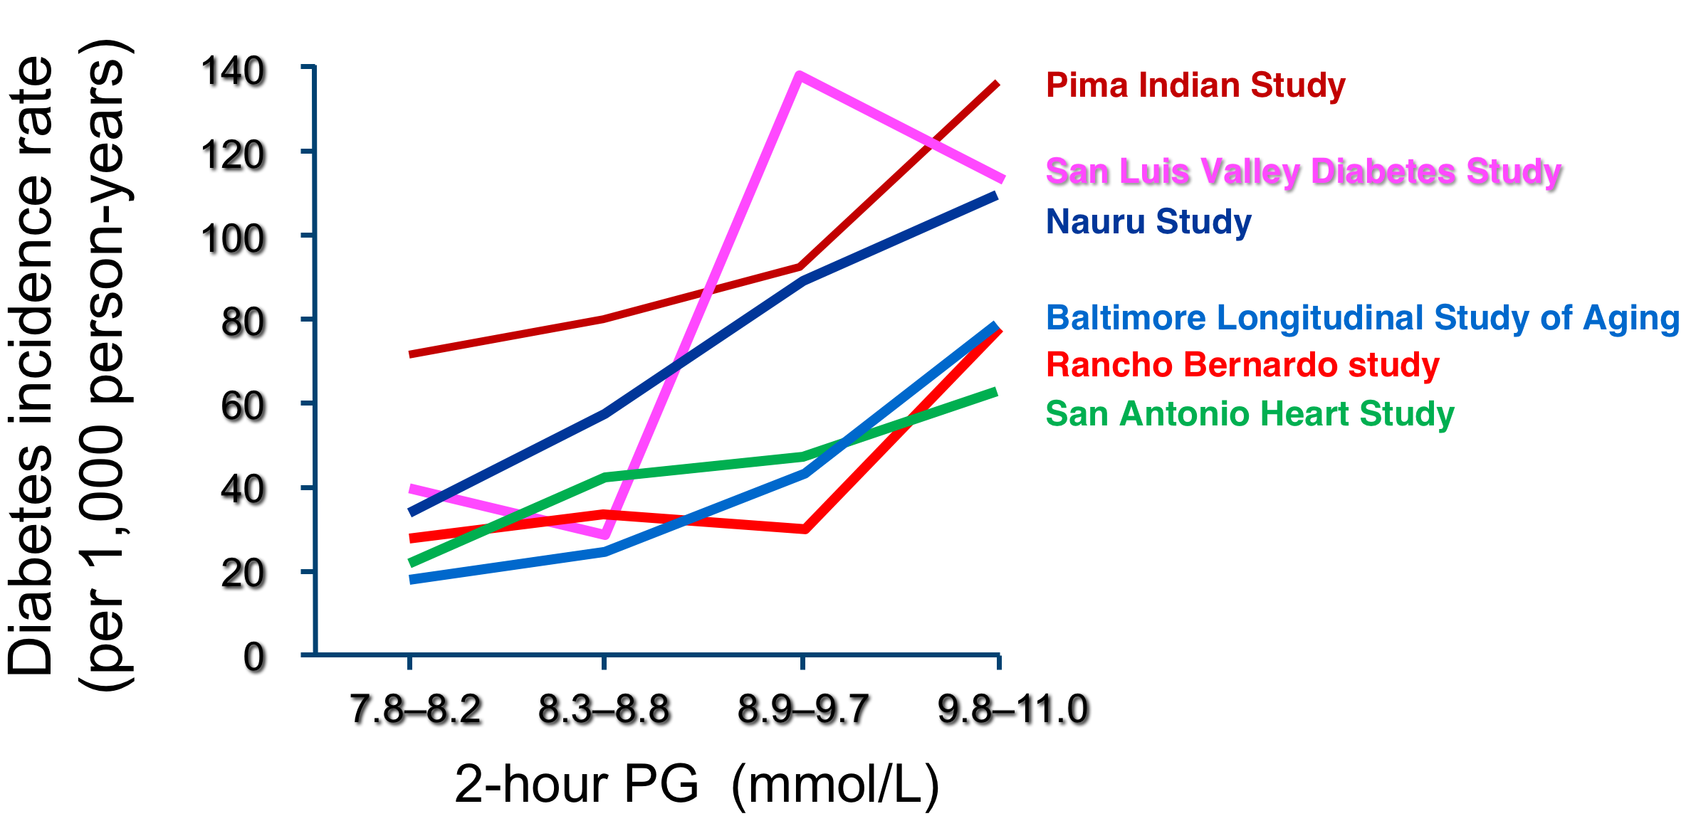
Diabetes Risk according to 75 g OGTT 2h Plasma Glucose Levels in IGT
Adapted from: Edelstein, S et al. 1997;Diabetes 46:701–710.

Slide 5
Post-challenge Hyperglycaemia and CHD Mortality
Honolulu
Heart Program
1987⁸
DECODA
2004¹
DECODE
2001²
Pacific and
Indian Ocean
1999³
Diabetes
Intervention Study
1996⁷
Postprandial
hyperglycaemia
Cardiovascular
mortality
Funagata
Diabetes Study
1999⁴
Rancho Bernardo Study
1998⁶
Whitehall, Paris
and Helsinki Study 1998⁵
1. Nakagami T, et al. Diabetologia 2004;47:385–94.
2. DECODE. Diabetes Care 2003;26:688–96.
3. Shaw J, et al. Diabetologia 1999;42:1050–54.
4. Tominaga M, et al. Diabetes Care 1999;22;920–24.
5. Balkau B, et al. Diabetes Care 1998;21:360–67.
6. Barrett-Connor E, et al. Diabetes Care 1998;21:1236–39.
7. Hanefeld M, et al. Diabetologia 1996;39:1577–83.
8. Donahue R. Diabetes 1987;36:689–92.
DECODA: Diabetes Epidemiology, Collaborative Analysis of Diagnostic Criteria in Asia
DECODE: Diabetes Epidemiology, Collaborative Analysis of Diagnostic Criteria in Europe

Slide 6
Acarbose and its Effects on Cardiovascular Risk Factors
Decreases postprandial glucose excursions in an insulin sparing manner by delaying breakdown of ingested polysaccharides to monosaccharides
PPG ↓
Insulin ↓
Proinsulin ↓
Positive gut microbiota effect
FPG ↓
FFA ↓, TG ↓
GLP-1↑
Weight ±
Hypertension ↓
Insulin resistance ↓
Oxidative stress ↓
PAI-1 ↓
CRP ↓
NFkB activation ↓
Endothelial function +
Intima media thickness ↓
Direct
Indirect
Rosak C et al. Diabetes Metab Syndr Obes 2012
Standl E et al. Cardiovascular Diabetology 2014

Slide 7
STOP-NIDDM: Reduced IGT Progression to T2DM
Acarbose 100mg TID vs. placebo in 1429 IGT subjects with 3 year follow-up
Relative reduction in the incidence of type 2 diabetes
Based on one
positive OGTT
Based on two consecutive
positive OGTTs
↓25%
↓36%
P=0.0015 vs. placebo
P=0.0003 vs. placebo
Relative increase in the reversion to normal glucose tolerance
↑35%
P<0.0001 vs. placebo,
Chiasson JL et al. Lancet 2002; 359: 2072–77.

Slide 8
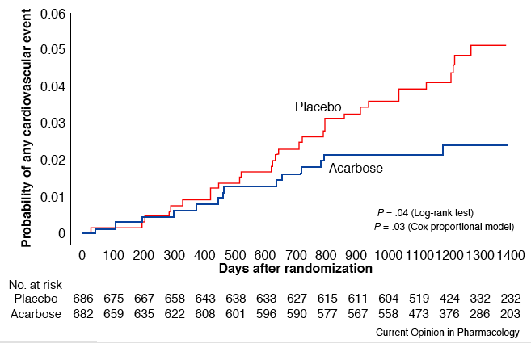
STOP-NIDDM: Impact of Acarbose on Cardiovascular Events
Any Cardiovascular Event
HR 0.51, 95%CI 0.28, 0.95
P = 0.03 (15 vs. 32 subjects with ≥1 event)
Chiasson et al J JAMA 2003;290:486-494.

Slide 9
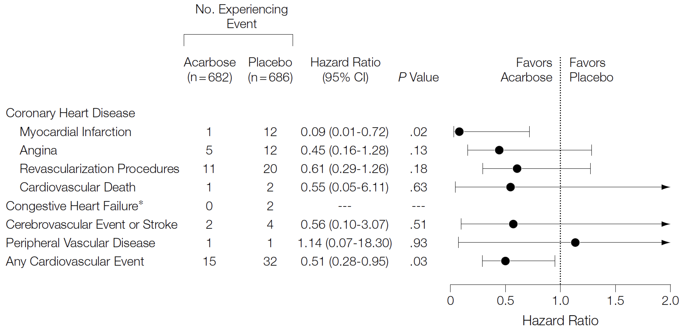
STOP-NIDDM: Impact of Acarbose on Cardiovascular Events
Adapted from Chiasson, J.-L. et al. JAMA 2003;290:486-494.

Slide 10
Chinese Diabetes Prevention Study
321 subjects with impaired glucose tolerance
N=85
N=60
N=88
N=88
Yang W. et al. Chin J Endocrinol Metab 2001;17:131–136.

Slide 11
Rationale for ACE Trial
Accumulating evidence suggests a close association between prediabetes and cardiovascular disease
Post-prandial hyperglycaemia may explain the excess risk seen in “prediabetes” and diabetes
Reducing post-prandial hyperglycaemia with acarbose has been reported to reduce CVD risk¹ in “prediabetes”
However, the impact on new CVD events in individuals with existing CVD and prediabetes is unknown
1. Chiasson et al. JAMA 2003;290:486-94.

Slide 12
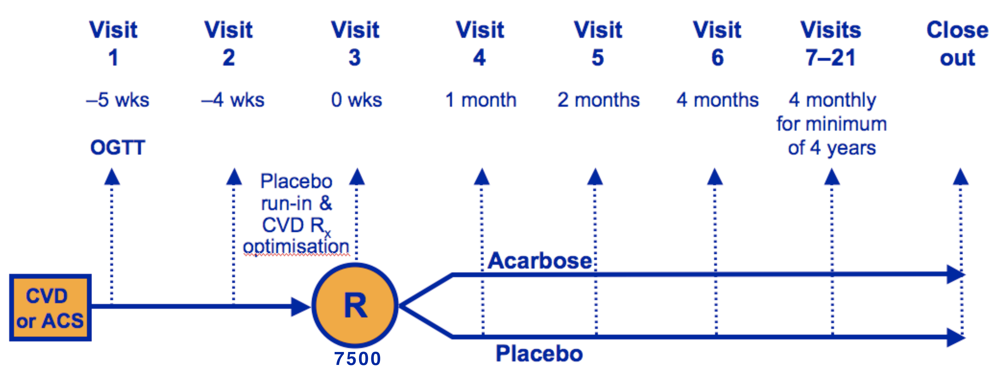
ACE: Trial Flow Chart
CHD
CHD
and IGT
6526
6,526 patients randomised between March 20th 2009 and October 23rd 2015
6,522 included in the intention to treat analysis
Participant closeout was from 1 December 2016 to 18 April 2017
Holman RR et al. American Heart Journal 2014;168:23-29.
Holman RR et al. Int J Endocrinol Metab 2016;36:1-4.

Slide 13
ACE: Trial Design
Multicentre, randomised, placebo-controlled, double-blind, secondary-prevention cardiovascular outcome trial in patients with pre-existing coronary heart disease and impaired glucose tolerance
Conducted in China to ICH-GCP standards
Academic led, analysed and reported
Sponsor: University of Oxford
Funding: Bayer AG
Holman RR et al. American Heart Journal 2014;168:23-29.
Holman RR et al. Int J Endocrinol Metab 2016;36:1-4.

Slide 14
Study Medication
Patients assigned at random to acarbose (50 mg TID) or matching placebo given
in addition to fully optimised usual CVD care
Tablets taken with meals using a ‘start low, go slow’ dose titration regimen
A 50mg dose of acarbose was selected as:
  It is the dose most commonly recommended in China for people with IGT
  There was a concern at the high non-adherence rate seen with the 100mg dose used in STOP-NIDDM (31% acarbose vs.19% placebo)
  Gastrointestinal side effects are known to be dose dependent
Holman RR et al. American Heart Journal 2014;168:23-29.
Holman RR et al. Int J Endocrinol Metab 2016;36:1-4.

Slide 15
ACE Primary Outcome
Five-point cardiovascular composite outcome, defined as the time to the first occurrence after randomisation of any of:
  Cardiovascular death, or
  Nonfatal myocardial infarction, or
  Nonfatal stroke, or
  Hospitalisation for unstable angina, or
  Hospitalisation for heart failure
Superiority analysis
Event driven requiring ≥728 participants with a confirmed composite primary outcome for 85% power to detect a 20% risk reduction in the primary outcome (two-sided alpha=0.05)
These last two components were added to the
primary outcome before database lock by the
Steering Committee given the substantially lower than anticipated blinded event rates observed during the trial
Holman RR et al. American Heart Journal 2014;168:23-29.
Holman RR et al. Int J Endocrinol Metab 2016;36:1-4.

Slide 16
Secondary Outcomes
  Three-point cardiovascular composite outcome
  (defined as cardiovascular death, nonfatal myocardial infarction, nonfatal stroke)
All-cause death
Individual components of the primary outcome
Proportion of participants developing diabetes
(confirmed by two successive diagnostic plasma glucose values)
Proportion of participants developing impaired renal function
(defined as ≥1 of eGFR <30 ml/min/1.73m², doubling of baseline serum creatinine level, or halving of baseline eGFR)
Health economic evaluation (to be reported elsewhere)
Holman RR et al. American Heart Journal 2014;168:23-29.
Holman RR et al. Int J Endocrinol Metab 2016;36:1-4.

Slide 17
Endpoint Adjudication
Two independent Endpoint Adjudication Committees, masked to therapy allocation, reviewed:
All potential cardiovascular endpoints
All reports of suggested diabetes not diagnosed per protocol by oral glucose tolerance tests (OGTTs)
Holman RR et al. American Heart Journal 2014;168:23-29.
Holman RR et al. Int J Endocrinol Metab 2016;36:1-4.

Slide 18
Major Inclusion/Exclusion Criteria
Male or female, aged 50 years or more
Coronary heart disease, defined as any of:
  Previous myocardial infarction and/or
  Previous unstable angina and/or
  Current stable angina
Impaired glucose tolerance when screened with an oral glucose tolerance test:
  Fasting plasma glucose <7.0 mmol/L (<126 mg/dl)
  2-hour plasma glucose ≥7.8 mmol/L and <11.1 mmol/L (≥140 mg/dl and <200 mg/dl)
Optimized cardiovascular drug therapy, with no planned revascularisation procedures
No history of diabetes (except gestational diabetes)
No myocardial infarction, unstable angina, stroke or TIA within the last 3 month
Holman RR et al. American Heart Journal 2014;168:23-29.
Holman RR et al. Int J Endocrinol Metab 2016;36:1-4.

Slide 19
Run-in Optimisation of Cardiovascular Therapy
Therapy for coronary heart disease was optimised (if required) during a four-week, single-blind, placebo run-in period to ensure usual care therapy conformed to international guidelines for treating patients with established coronary heart disease
Therapy should have included:
  Antiplatelet agents
  Statins
  Beta-blockers
  Renin-angiotensin-aldosterone inhibitors
  Blood pressure lowering therapy as appropriate
Investigators also provided appropriate lifestyle advice with respect to diet, exercise and smoking cessation
Holman RR et al. American Heart Journal 2014;168:23-29.
Holman RR et al. Int J Endocrinol Metab 2016;36:1-4.

Slide 20
Participant Characteristics

Slide 21
Previous Coronary Heart Disease*
Entry Criteria | Proportion
Previous myocardial infarction | 42%
Previous unstable angina | 42%
Stable angina | 22%
*not mutually exclusive

Slide 22
Baseline Patient Demographics
 | Acarbose N=3,272 | Placebo N=3,250
Mean age (years) | 64.4 | 64.3
≥65 | 45% | 44%
Female | 27% | 27%
Race
Han | 97% | 97%
Other | 3% | 3%
Region
West and East | 34% | 35%
South and Southwest | 20% | 20%
Beijing and Tianjin | 16% | 16%
Central | 14% | 15%
Northeast | 15% | 15%
Hong Kong | <1% | <1%
Baseline demographic characteristics did not differ between treatment groups

Slide 23
Baseline Clinical Characteristics
 | Acarbose N=3,272 | Placebo N=3,250
Body mass index (kg/m²) | 25.3 | 25.5
Blood Pressure (mmHg)
Systolic | 130 | 129
Systolic <140 | 73% | 72%
Diastolic | 78 | 78
Current smoker | 12% | 13%
Previous hypertension | 66% | 65%
Previous atrial fibrillation | 3.9% | 3.9%
Previous heart failure | 3.8% | 3.7%
Previous stroke | 6.4% | 6.7%
Previous coronary revascularisation | 48% | 47%
Data are mean or percentage
Baseline clinical characteristics did not differ between treatment groups

Slide 24
Baseline Biochemical Characteristics
 | Acarbose N=3,272 | Placebo N=3,250
Fasting plasma glucose (mmol/L) | 5.5 | 5.5
Two-hour plasma glucose (mmol/L) | 9.3 | 9.3
HbA_{1c} (mmol/mol) | 41 | 41
HbA_{1c} (%) | 5.9 | 5.9
eGFR (ml/min/1.73m²)* | 88 | 89
<60 ml/min/1.73m² | 7.2% | 7.7%
HDL-cholesterol (mmol/L) | 1.18 | 1.18
LDL-cholesterol (mmol/L) | 2.3 | 2.3
Triglycerides (mmol/L)* | 1.4 | 1.4
Baseline biochemical characteristics did not differ between treatment groups

Slide 25
Cardiovascular Therapies
 | Acarbose N=3,272 | Placebo N=3,250
Statins | 93% | 93%
Antiplatelet therapy
Aspirin | 94% | 94%
Aspirin plus other antiplatelet agent | 98% | 98%
Beta-blocker | 66% | 67%
Angiotensin-converting enzyme inhibitor or angiotensin receptor blocker | 59% | 59%
Calcium channel blocker | 30% | 29%
Nitrates | 36% | 37%
Baseline cardiovascular therapies did not differ between treatment groups
Cardiovascular risk factors were well managed to international guideline standards

Slide 26
Participant Follow-up, Changes in
Key Risk Factors and Safety Data

Slide 27
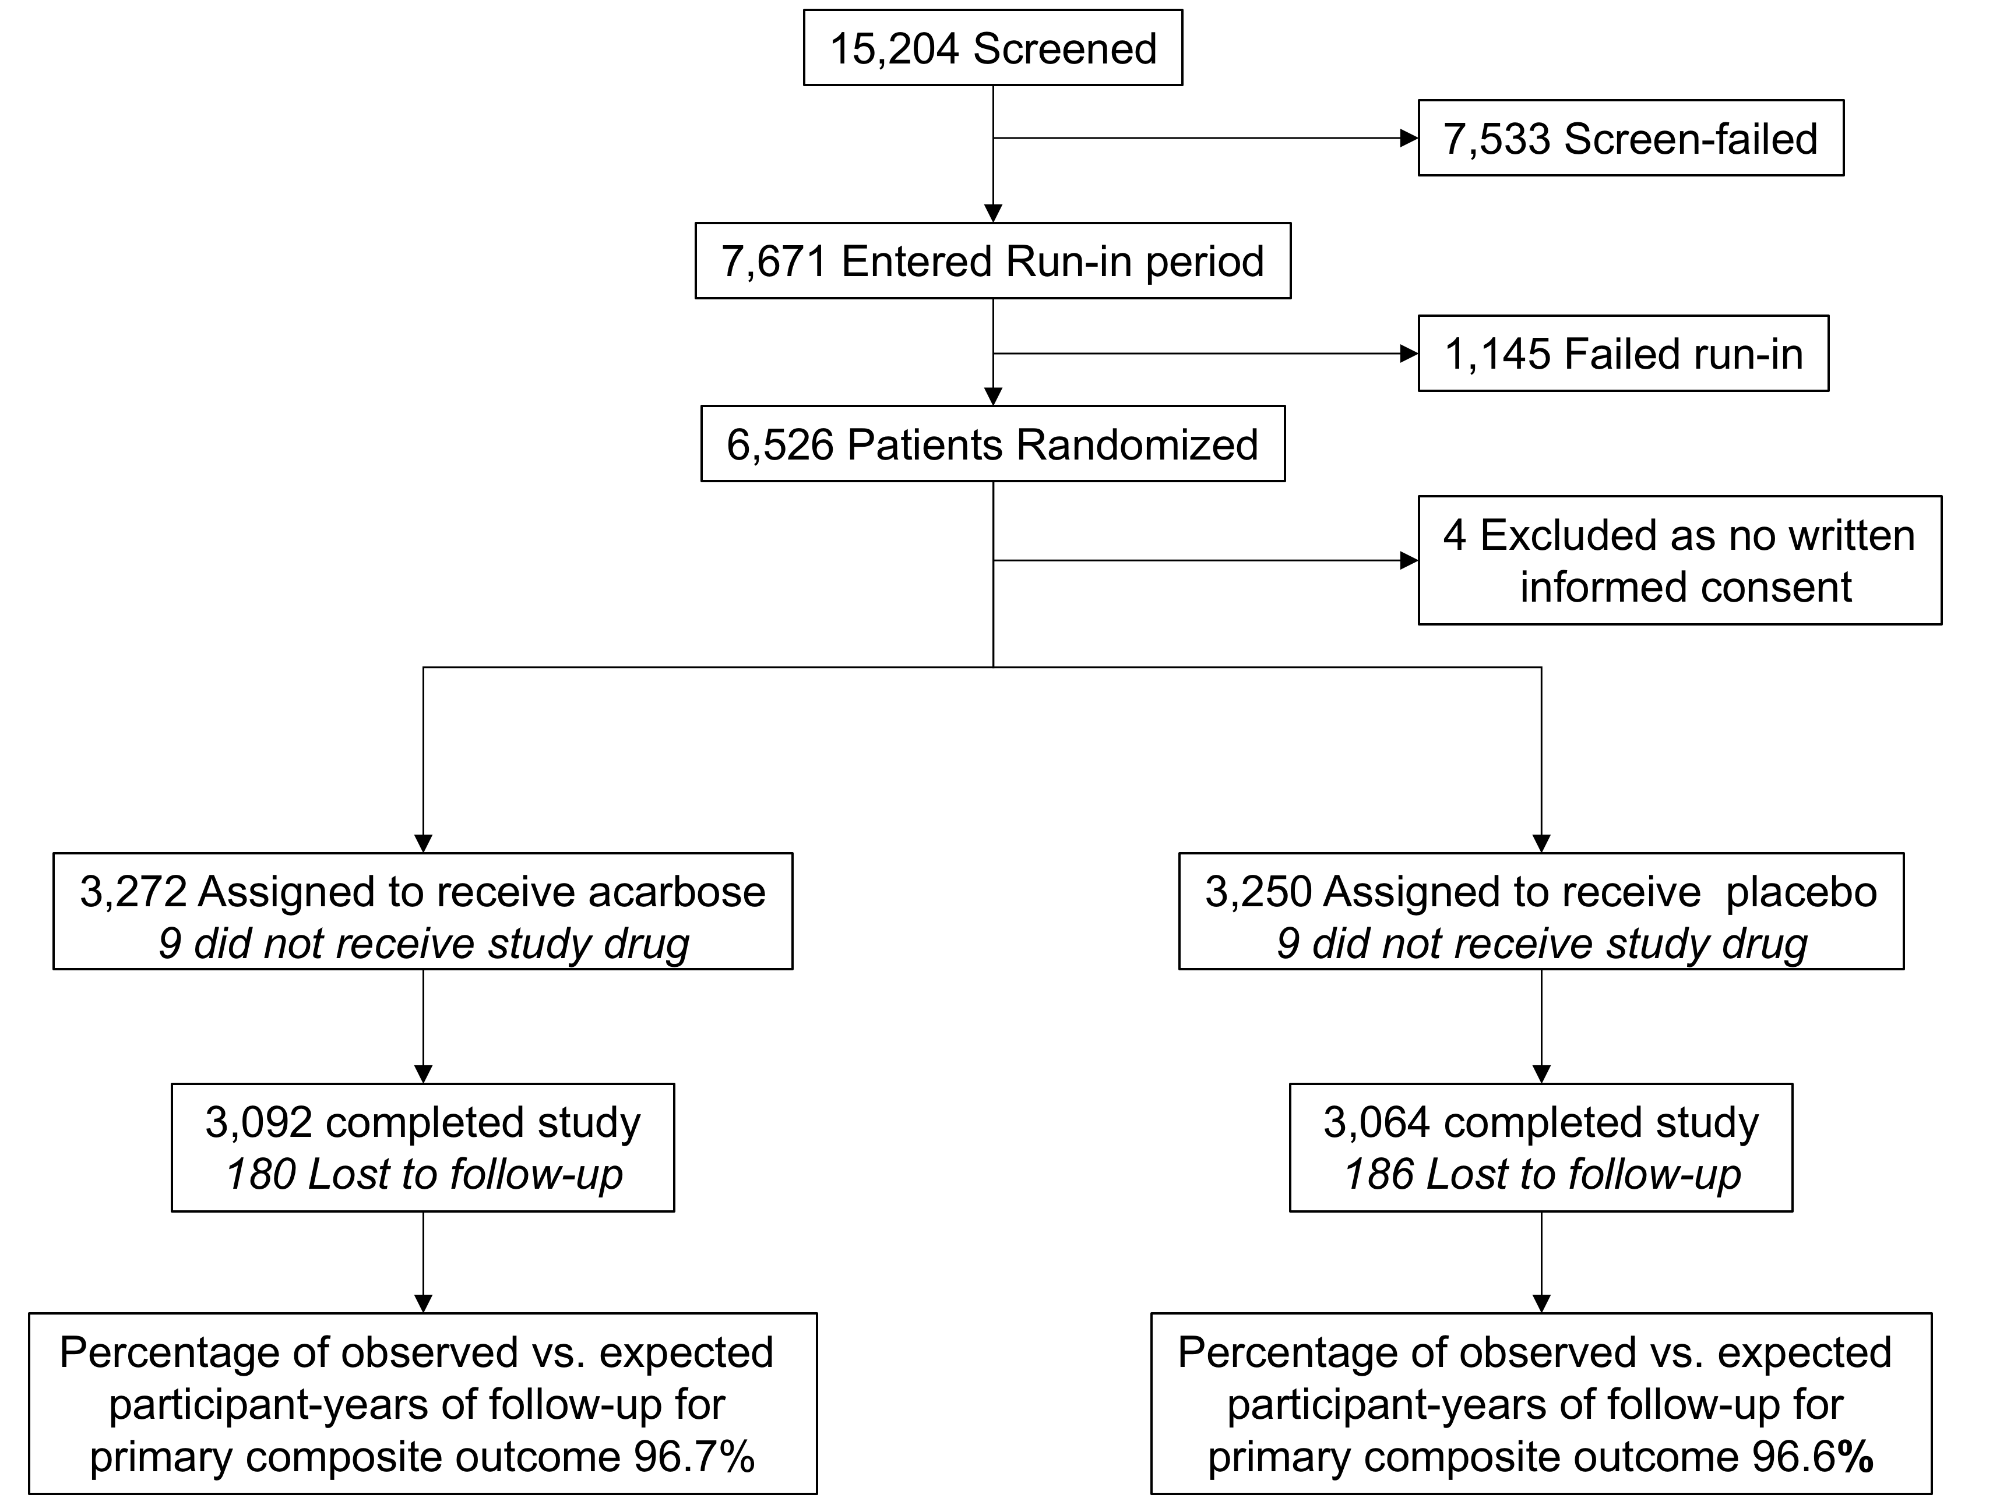
Enrollment, Follow-up and Vital Status

Slide 28
Participant Follow-up
Median follow up 5.0 years (IQR 3.4 to 6.0)
In total, 386 participants were lost-to-follow-up (5.6%)
Equates to 0.7% per year over 7 years vs. protocol anticipated ~0.6% per year
Percentage of observed vs. expected participant-years of follow-up for the primary composite outcome was 96.7% for acarbose and and 96.6% for placebo

Slide 29
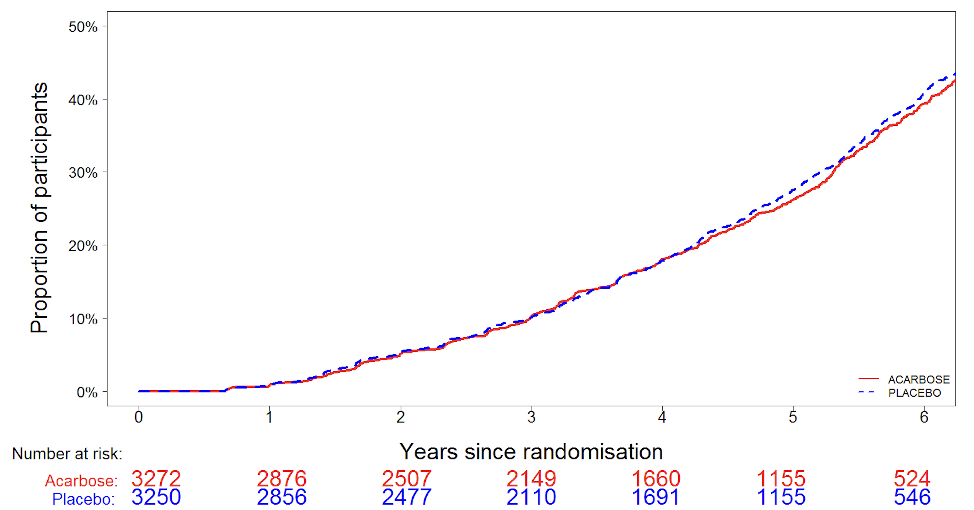
Study Medication Adherence
Adherence did not differ between treatment groups
The mean percentage of time participants received study drug was 77.5% in the acarbose group and 76.4% in the placebo group
Acarbose Placebo

Slide 30
Reasons for Study Medication Discontinuation
 | Acarbose N=3,272 | Placebo N=3,250
Permanent Discontinuation | 1,768 (49%) | 1,807 (51%)
Reason
Patient decision | 514 (16%) | 566 (17%)
Adverse event | 52 (1.6%) | 50 (1.5%)
Illness/Operation | 19 (0.6%) | 17 (0.5%)
Side effects | 36 (1.1%) | 25 (0.8%)
Other | 185 (5.7%) | 192 (5.9%)
No reason given | 962 (29%) | 957 (29%)

Slide 31
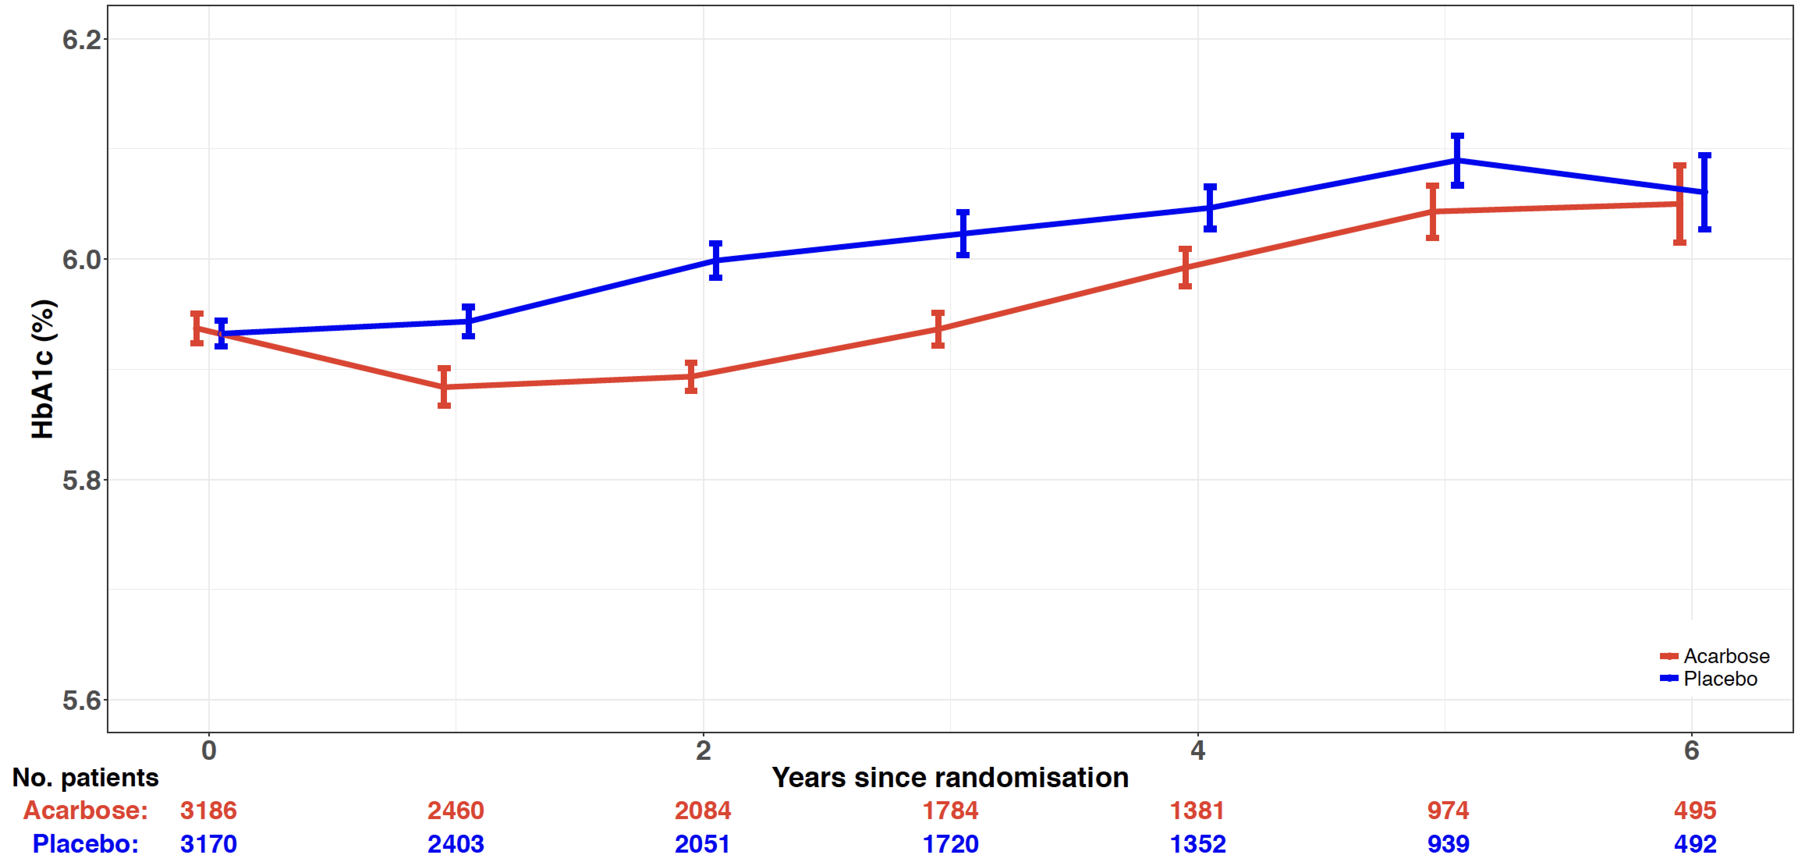

Mean HbA_{1c} Levels Over Six Years
Overall least-squares mean difference −0.07%
95% CI −0.04 to −0.10
p<0.0001
HbA1c (%)
Acarbose Placebo
0.0

Slide 32
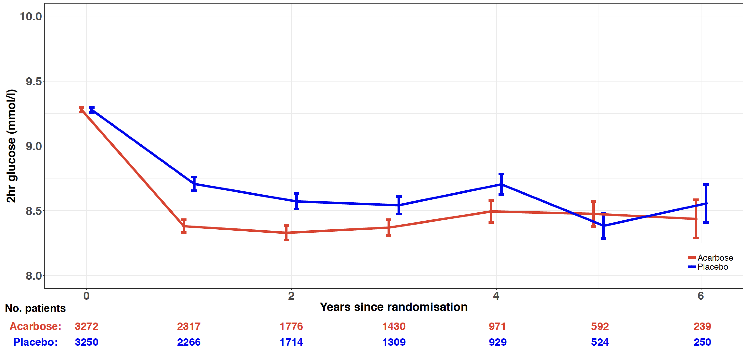
Mean Two-hour Plasma Glucose Levels Over Six Years
Overall least-squares mean difference −0.24 mmol/L
95% CI −0.16 to −0.32
p<0.0001
2 Hr Plasma Glucose (mmol/L)
Acarbose Placebo
0.0

Slide 33
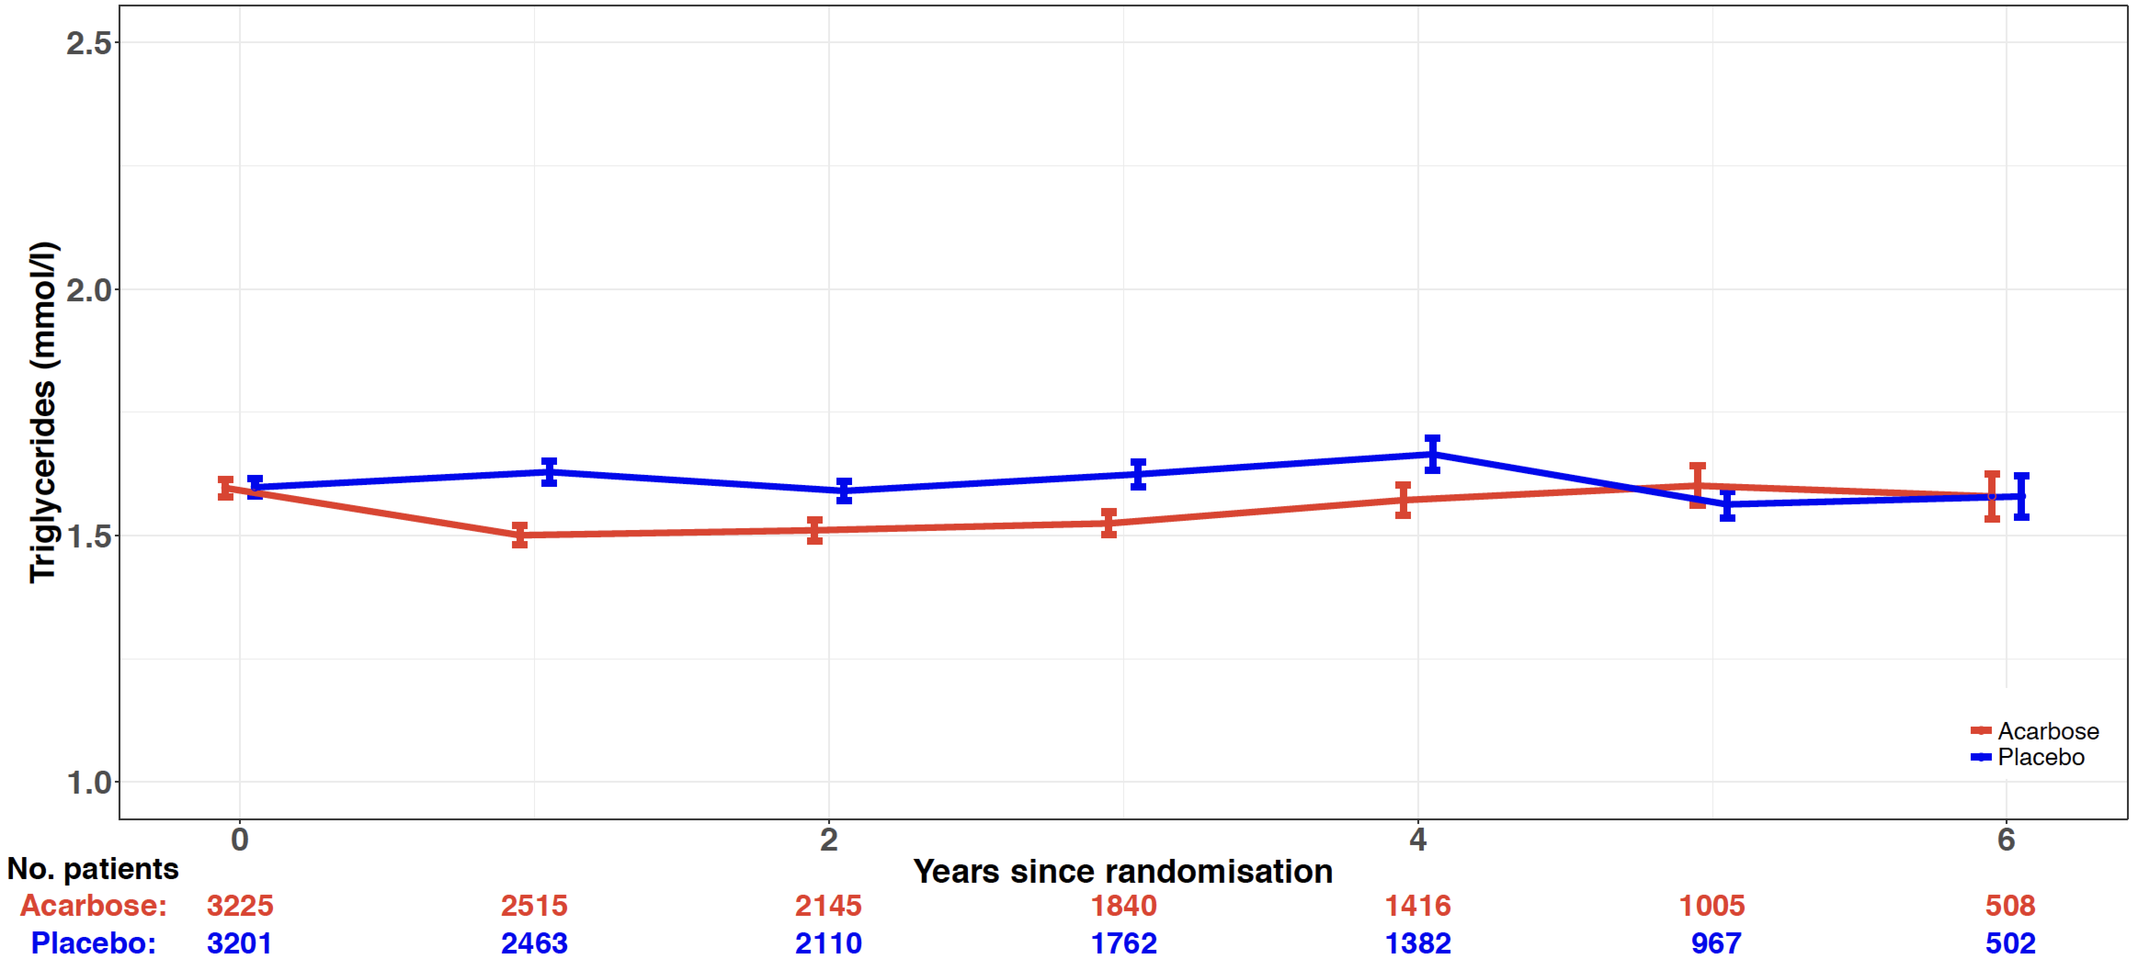
Mean Triglyceride Level Over Six Years
Overall least-squares mean difference −0.09 mmol/L
95% CI −0.07 to −0.12
p<0.0001
Tryglycerides (mmol/L)
Acarbose Placebo
0.0

Slide 34
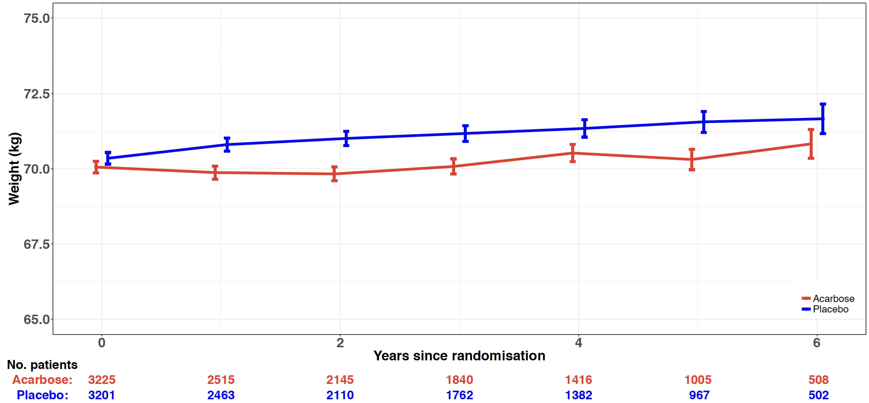
Mean Body Weight Over Six Years
Overall least-squares mean difference −0.64 kg
95% CI −0.53 to −0.75
p<0.0001
Body Weight (kg)
Acarbose Placebo
0.0

Slide 35
Safety Reporting
As acarbose is licensed in China for the treatment of impaired glucose tolerance, non-serious adverse events were not collected unless related to the cessation or a change in dose of study medication
Suspected Unexpected Serious Adverse Reactions (SUSARs) and Serious Adverse Events (SAEs) were reported to the China Food and Drug Administration (CFDA) if they were not study endpoints
Liver function was assessed annually by plasma alanine aminotransferase levels
Unmasked safety data was reviewed every six months by the independent Data Safety and Monitoring Board (DSMB)

Slide 36
Participants Reporting One or More Hypoglycaemic Episodes
 | Acarbose N=3,272 |  | Placebo N=3,250 |  | P value
 | No. of patients |  | No. of patients
Mild hypoglycaemia (Symptoms only) | 367 | 11% | 364 | 11% | 0.99
Severe hypoglycaemia (Requiring third party assistance) | 54 | 1.7% | 52 | 1.6% | 0.95

Slide 37
Adverse Events
MEDRA Coded | Acarbose N=3,263 | Placebo N=3,241
Serious Adverse Events* | Patients | Patients
Neoplasms benign, malignant and unspecified | 85 (2.6%) | 88 (2.1%)
Infections and infestations | 70 (2.1%) | 74 (2.3%)
Gastrointestinal disorders | 76 (2.3%) | 59 (2.0%)
Vascular disorders | 47 (1.4%) | 36 (1.1%)
Nervous system disorders | 37 (1.1%) | 26 (0.8%)
Drug Associated Adverse events†
Gastrointestinal disorders§ | 215 (6.6%) | 150 (4.6%)
* Serious adverse events are reported where they occur in ≥1% of participants in either treatment group
† Adverse events associated with drug discontinuation or dose changes are reported where they occur in ≥5% in either treatment group. § P<0·001

Slide 38
Haemorrhagic Adverse Events by Antiplatelet Therapy at Baseline*
 | Acarbose N=3,272 |  | Placebo N=3,250 |  | P value
Aspirin alone | 8/1173 | 0.68% | 8/1184 | 0.68% | 1.00
Aspirin plus other antiplatelet therapy | 31/1890 | 1.64% | 11/1897 | 0.59% | 0.002
* Post hoc analysis of the intention-to-treat population. Denominators in the table are the number of patients on drug at baseline
Higher rates would be expected with dual antiplatelet therapy but this is seen only in the acarbose group

Slide 39
Cardiovascular Outcomes

Slide 40
ACE Primary Five-point Cardiovascular Composite Outcome
Defined as the time to the first occurrence after randomisation of any of:
  Cardiovascular death, or
  Nonfatal myocardial infarction, or
  Nonfatal stroke, or
  Hospitalisation for unstable angina, or
  Hospitalisation for heart failure
Holman RR et al. American Heart Journal 2014;168:23-29
Holman RR et al. Int J Endocrinol Metab 2016;36:1-4

Slide 41
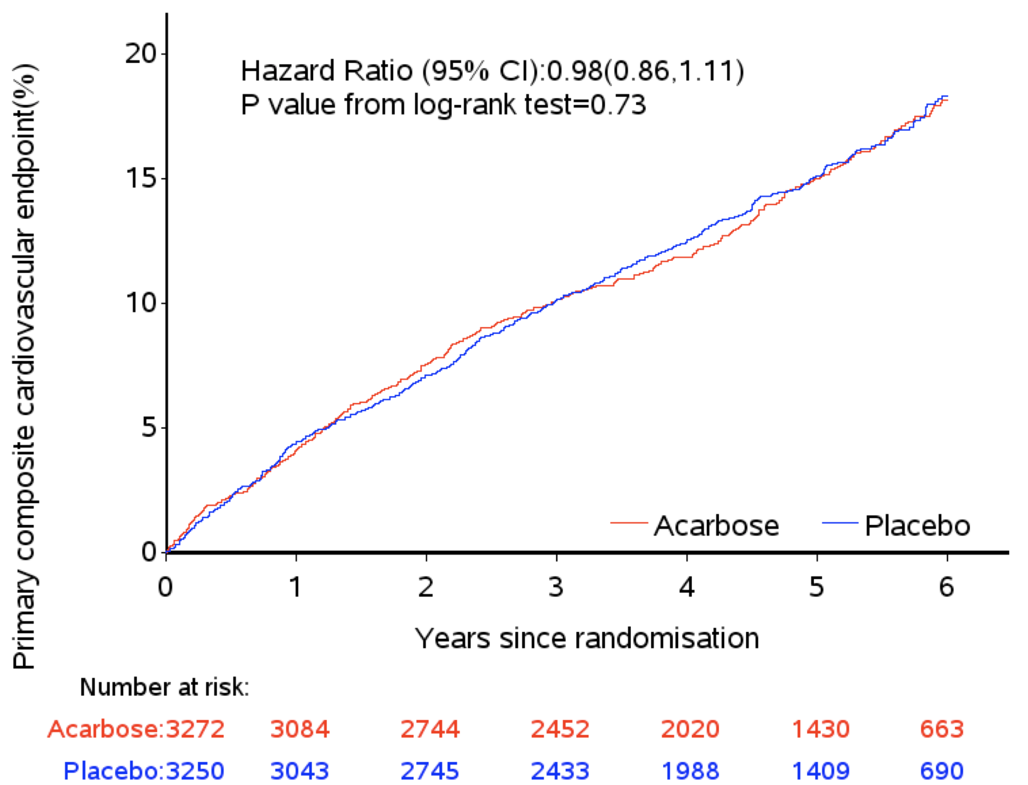
Five-point Primary Outcome (ITT analysis)
Acarbose: 14.4% (470), 3·33 per 100 person-years
Placebo: 14.7% (479), 3·41 per 100 person-years
Acarbose Placebo

Slide 42
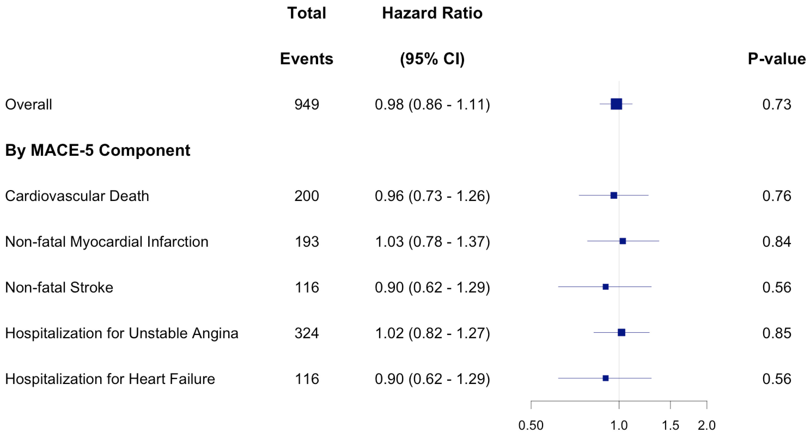
Hazard Ratios for the Components of the Primary Outcome

Slide 43
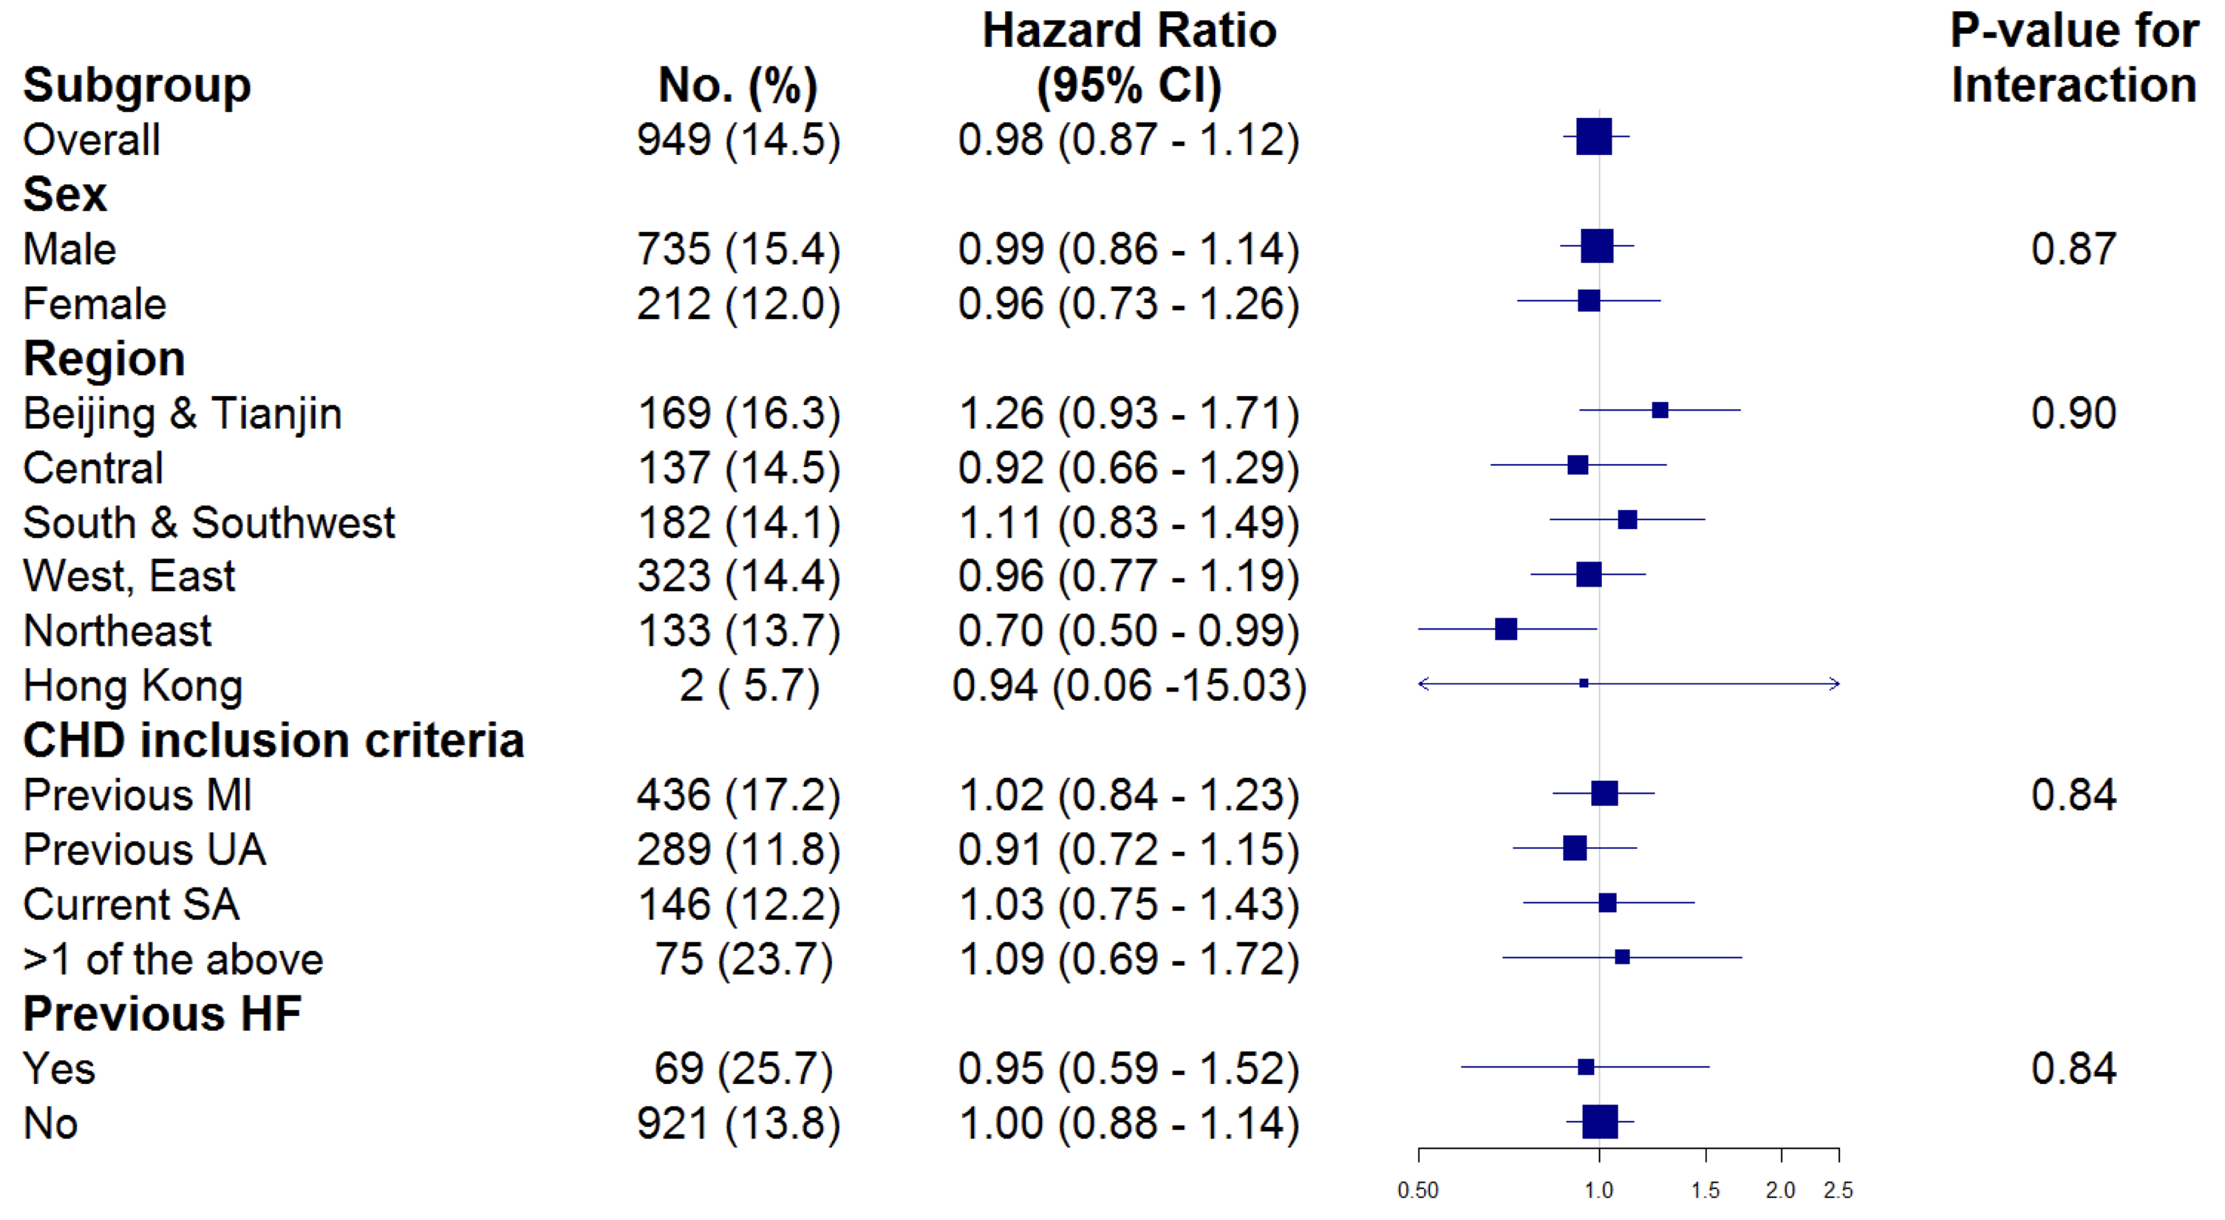
Prespecified Subgroup Analyses for the Primary Outcome (1)
0.50
1.0
1.5
2.0
2.5

Slide 44
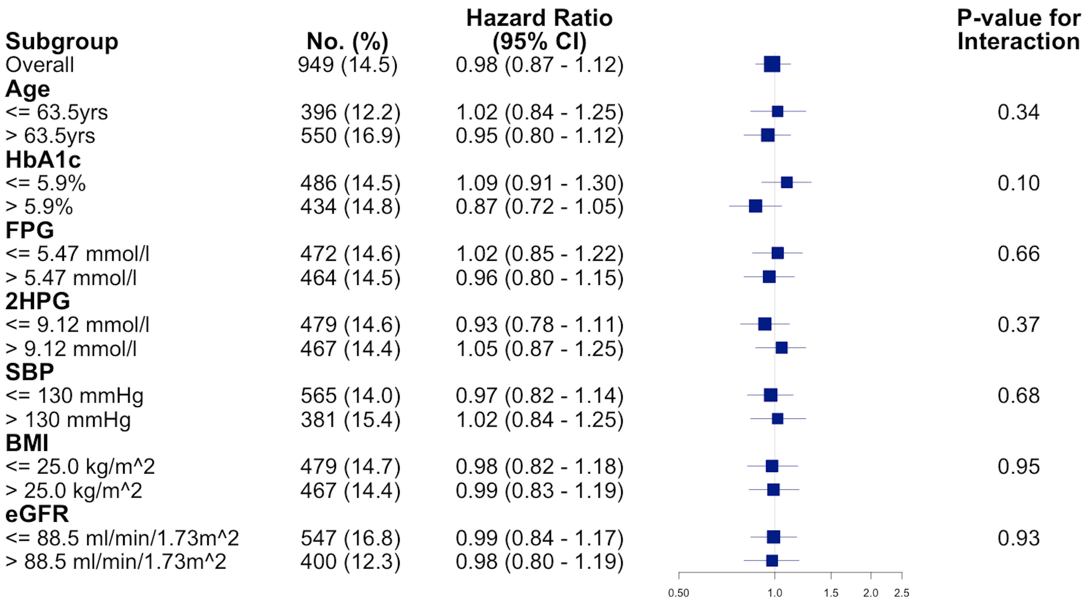
Prespecified Subgroup Analyses for the Primary Outcome (2)
2
2
2
2
0.50
1.0
1.5
2.0
2.5

Slide 45
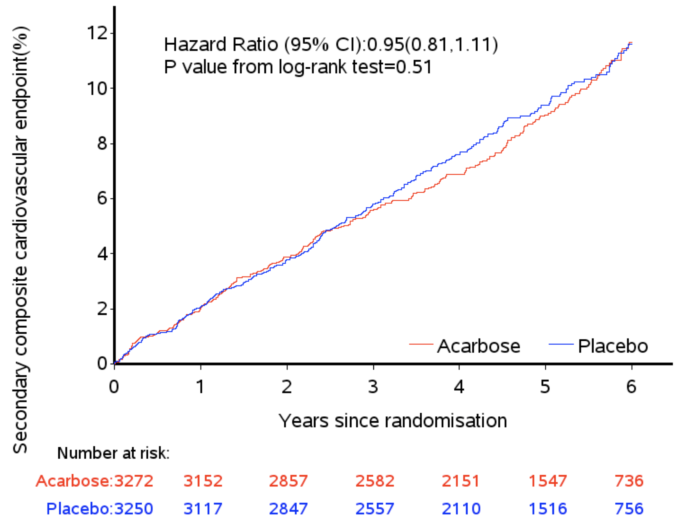
Three-point MACE Secondary Outcome (ITT analysis)
Acarbose: 8.7% (285), 1.93 per 100 person-years
Placebo: 9.2% (299), 2.04 per 100 person-years
Acarbose Placebo

Slide 46
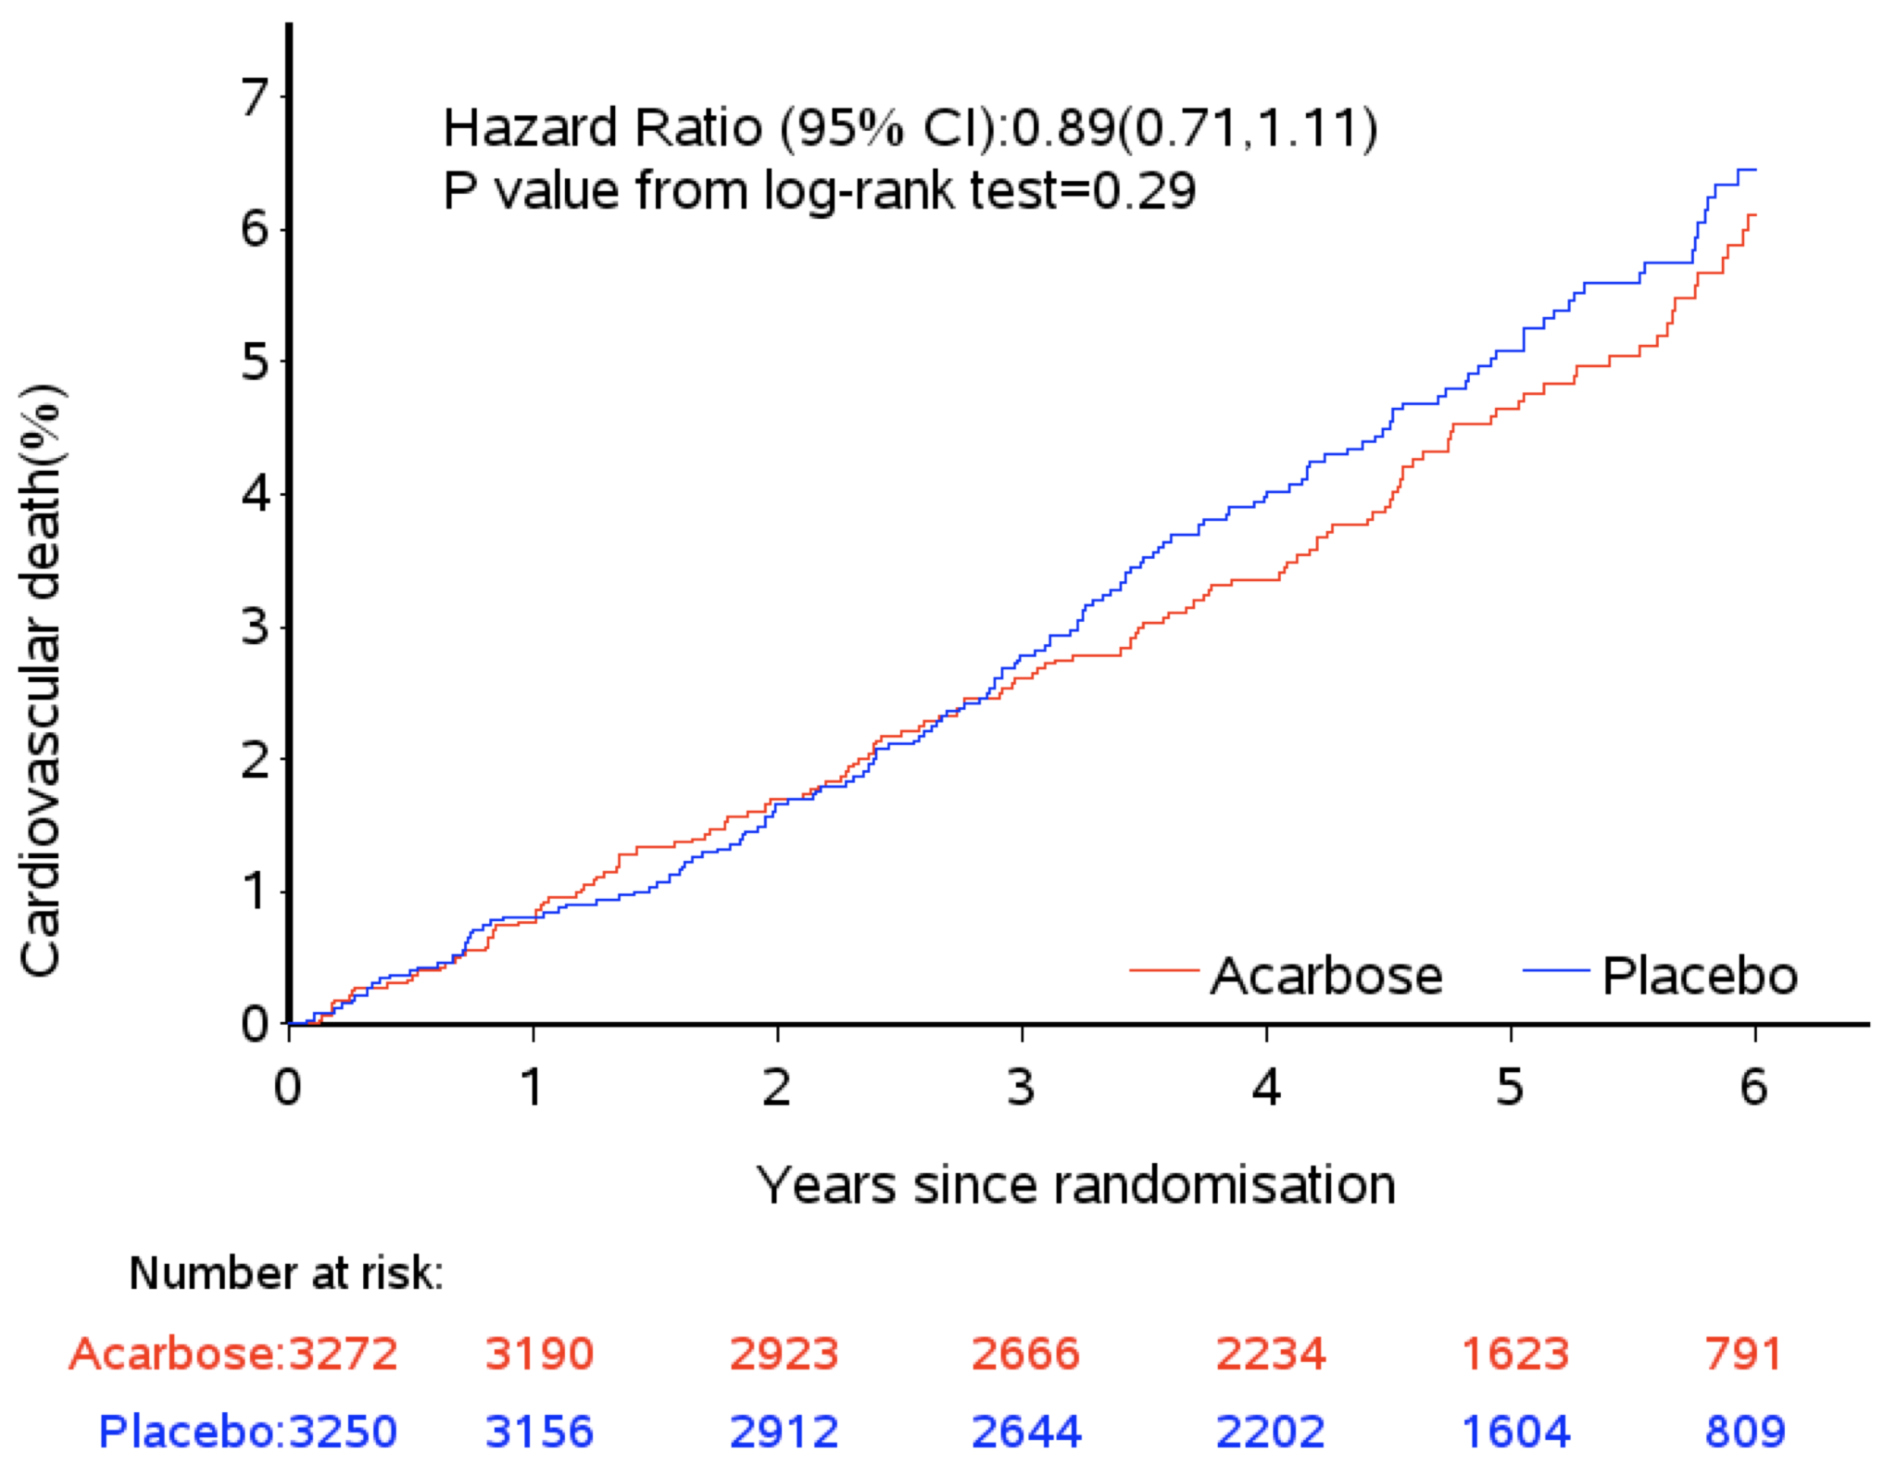
Cardiovascular Death
Acarbose: 4.4% (145), 0.96 per 100 person-years
Placebo: 5.0% (163), 1.03 per 100 person-years
Acarbose Placebo

Slide 47
Secondary Outcomes
 | Acarbose N=3,272 |  | Placebo N=3,250 |  | Hazard Ratio (95% CI) | P Value
 | No. (%) | No. per 100 pyrs | No. (%) | No. per 100 pyrs
Cardiovascular death, non-fatal myocardial infarction or non-fatal stroke (3-point MACE) | 285 (8.7) | 1.93 | 299 (9.2) | 2.04 | 0.95 (0.81 to 1.11) | 0.51
Death from any cause | 216 (6.6) | 1.42 | 219 (6.7) | 1.45 | 0.98 (0.81 to 1.19) | 0.85
Cardiovascular death | 145 (4.4) | 0.96 | 163 (5.0) | 1.03 | 0.89 (0.71 to 1.11) | 0.29
Fatal or non-fatal myocardial infarction | 122 (3.7) | 0.82 | 108 (3.3) | 0.73 | 1.12 (0.87 to 1.46) | 0.38
Fatal or non-fatal stroke | 75 (2.3) | 0.50 | 77 (2.4) | 0.52 | 0.97 (0.70 to 1.33) | 0.83
Hospitalisation for unstable angina | 174 (5.3) | 1.19 | 170 (5.2) | 1.17 | 1.02 (0.82 to 1.26) | 0.87
Hospitalisation for heart failure | 65 (2.0) | 0.43 | 73 (2.2) | 0.49 | 0.89 (0.63 to 1.24) | 0.48

Slide 48
Glycaemic and Renal Outcomes

Slide 49
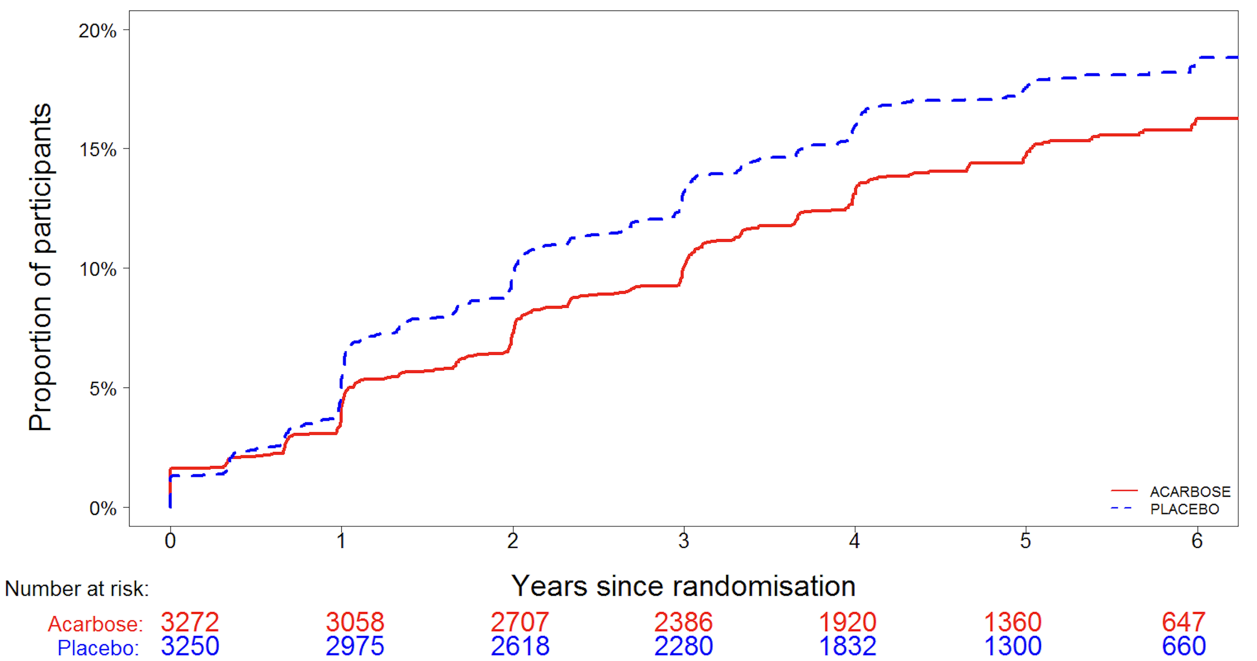
New-onset Diabetes
Rate ratio 0.82, 95% CI 0.71 to 0.94, P=0.005
Acarbose: 13% (436), 3·17 per 100 person-years
Placebo: 16% (513), 3·84 per 100 person-years
Number needed to treat to prevent
one case of diabetes over five years = 41
Acarbose Placebo

Slide 50
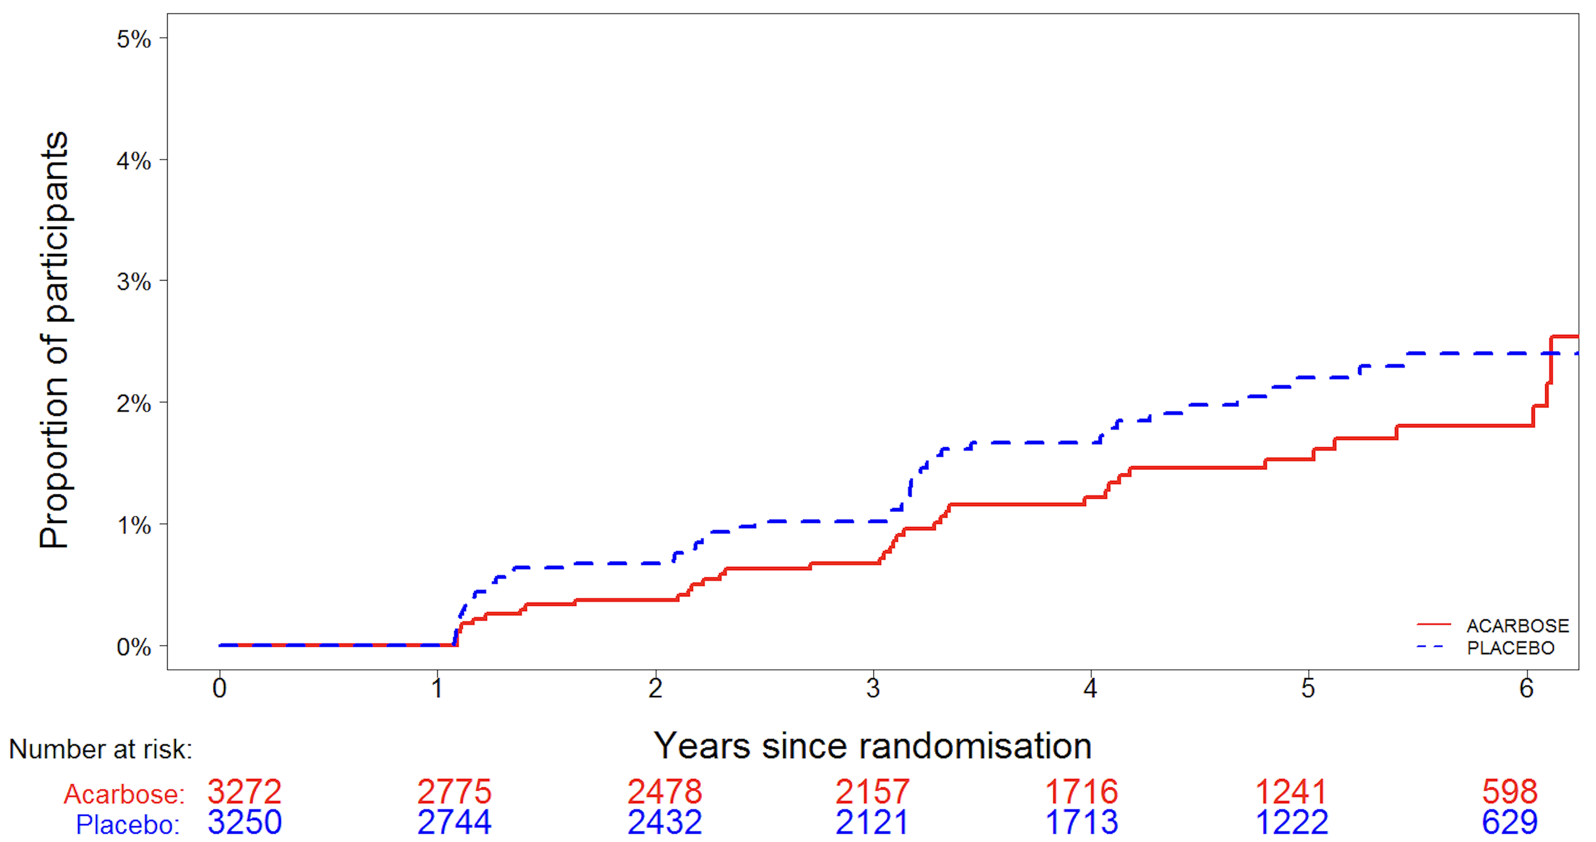
New-onset Impaired Renal Function
Rate ratio 0.81, 95% CI 0.54 to 1.23, P=0.33
Acarbose: 1.3% (41), 0·33 per 100 person-years
Placebo: 1.5% (50), 0·41 per 100 person-years
Acarbose Placebo

Slide 51
Summary (1)
Overall mean differences in cardiovascular risk factor levels during the study | Acarbose minus Placebo | P Value
HbA_{1c} (%) | -0.07, -0.04 to -0.10 | <0.0001
2 Hr plasma glucose (mmol/L) | -0.24, -0.16 to -0.32 | <0.0001
Triglycerides (mmol/L) | -0.09, -0.07 to -0.12 | <0.0001
Body weight (kg) | -0.64, -0.53 to -0.75 | <0.0001

Slide 52
Summary (2)
 | Acarbose N=3,272 |  | Placebo N=3,250 |  | Hazard Ratio (95% CI) | P Value
Primary Outcome | No. (%) | No. per 100 pyrs | No. (%) | No. per 100 pyrs
5-point MACE | 470 (14.4) | 3.33 | 479 (14.7) | 3.41 | 0.98 (0.86 to 1.11) | 0.73
Key Secondary Outcomes
3-point MACE | 285 (8.7) | 1.93 | 299 (9.2) | 2.04 | 0.95 (0.81 to 1.11) | 0.51
Death from any cause | 216 (6.6) | 1.42 | 219 (6.7) | 1.45 | 0.98 (0.81 to 1.19) | 0.85
Cardiovascular death | 145 (4.4) | 0.96 | 163 (5.0) | 1.03 | 0.89 (0.71 to 1.11) | 0.29
Hospitalisation for heart failure | 65 (2.0) | 0.43 | 73 (2.2) | 0.49 | 0.89 (0.63 to 1.24) | 0.48
New-onset diabetes | 436 (13) | 3.17 | 513 (16) | 3.84 | 0.82 (0.71 to 0.94) | 0.005

Slide 53
Conclusions
In Chinese patients with coronary heart disease and impaired glucose tolerance:
The ACE trial did not confirm the suggestion from the STOP-NIDDM trial that acarbose might reduce cardiovascular risk in people with impaired glucose tolerance
The ACE trial did show that acarbose reduced the incidence of diabetes by 18%, with a number needed to treat for five years of 41
These results extend the knowledge of the safety of acarbose and its efficacy for delaying the onset of diabetes to a population with both coronary heart disease and impaired glucose tolerance
The reduced incidence of diabetes seen with acarbose in the ACE trial might help to reduce cardiovascular risk in the longer term by delaying the onset of diabetes in the high-risk population studied, as was seen in the 23 year follow-up of the Da Qing study

Slide 54
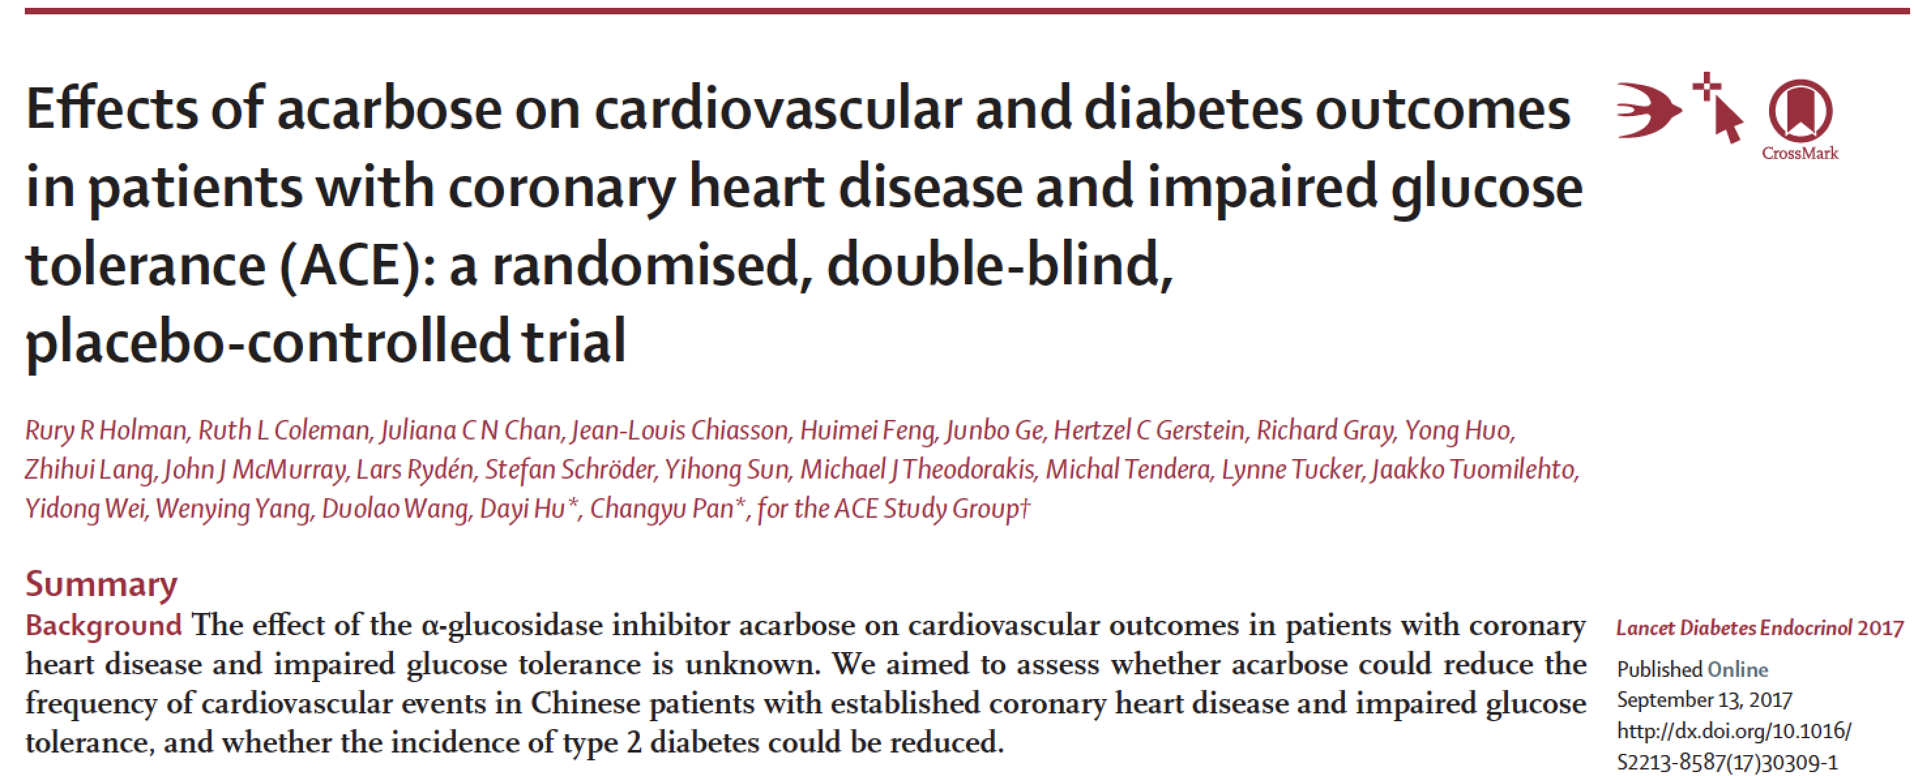
Paper Now On-line in The Lancet Diabetes and Endocrinology
Slide deck now available @ www.ACE-study.org

